Slide 1
Brightness of Horizontal (H5) and Vertical (H1) Cold Sources
Ken Andersen

Slide 2
H5
H1

Slide 3
Extract Brightness from Neutron Measurement
Needs end-of-guide position with chopper and TOF analysis
  Readily available on H1: Figaro, D17, PF1B
  Not so readily available on H5 (IN15?)
Propagate backwards
Correct for attenuation through window materials etc.
Scale using Au-foil measurement

Slide 4
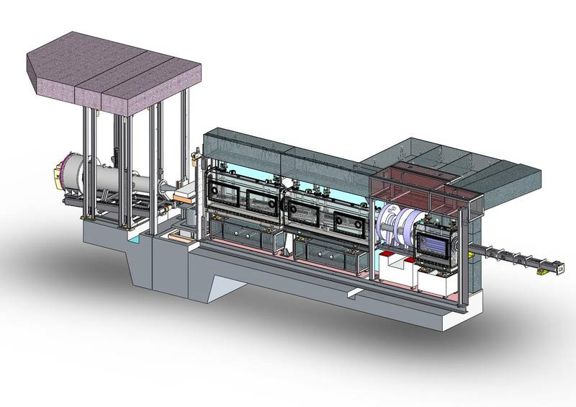
Use spectrum measured on Figaro (H172)

Slide 5
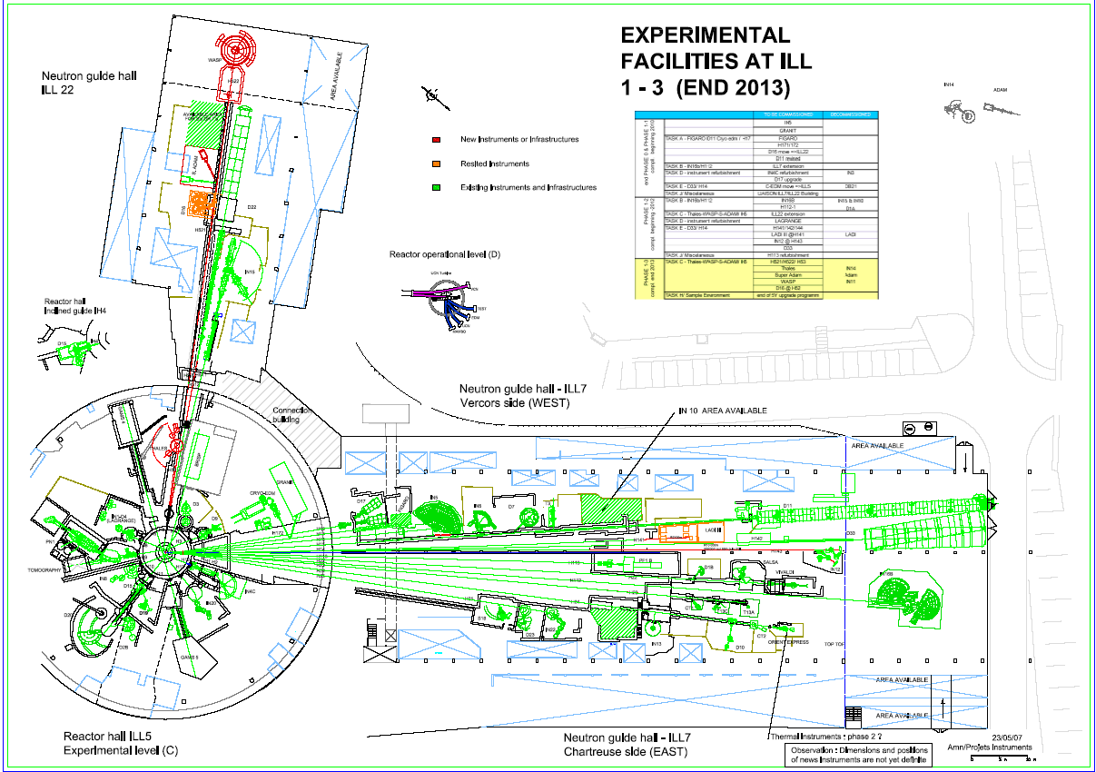

Slide 6
Detector spectrum corrected for chopper opening time
Δt
Δt
distance
time

Slide 7
Al Bragg edges measured on D17

Slide 8
Al window transmission
T=0.875
⇒t=20mm

Slide 9
Al window transmission

Slide 10
Detector efficiency
Window thickness = 10mm
- half of the total 20mm

Slide 11
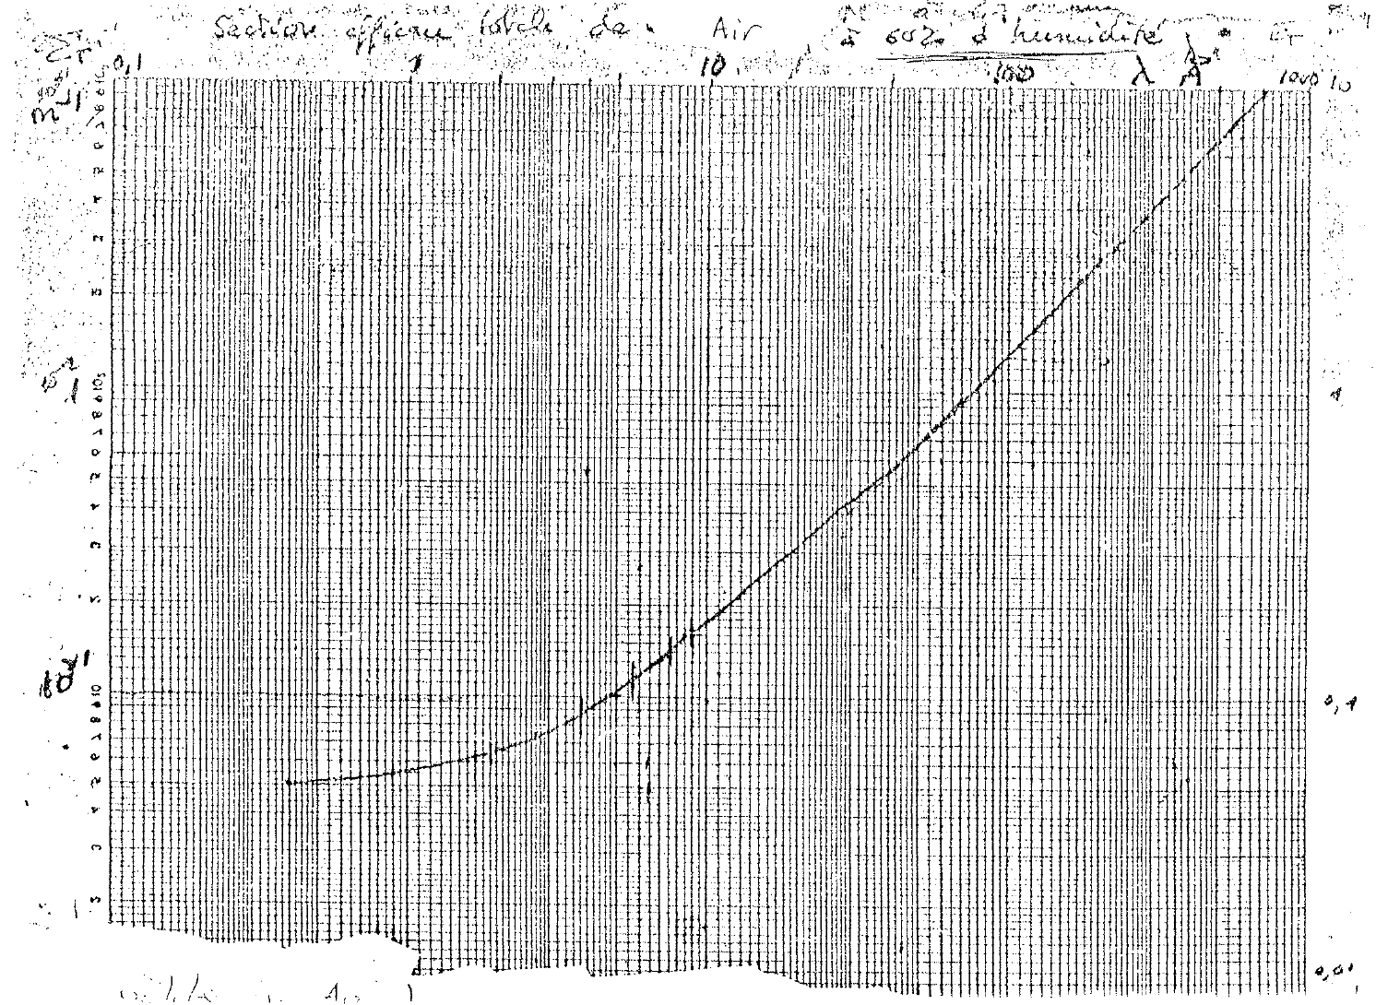
Air attenuation
Ageron measurement at 60% humidity
50cm through air

Slide 12
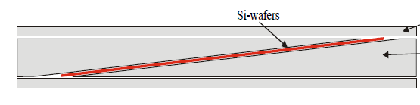
Attenuation through frame-overlap mirror
0.7mm Si at 3° angle

Slide 13
Final corrected spectrum
Flux (arb. units)

Slide 14
Propagate backwards through guide

Slide 15
Gold foil measurement
August 2007
after installation of H17 guides
at VS position: entrance into level C casemate
H171 (Figaro) Φ_{capt}=1.07×10¹⁰ n/cm²/s
H172 (Granit) Φ_{capt}=1.57×10¹⁰ n/cm²/s

Slide 16
Evaluate capture flux at VS and rescale

Slide 17
Comparison of capture fluxes
Capture Flux (n/cm²/s) | Measured | Calculated from Ageron | Present calculation
H171 (Figaro) VS | 4.24×10¹⁰ ^{August 2007} | 2.88×10¹⁰ | (4.24×10¹⁰)
H172 (Granit) VS | 6.19×10¹⁰ ^{August 2007} | 4.03×10¹⁰ | 5.98×10¹⁰
H172 (Granit) mono | 4.4-4.8×10¹⁰ ^{April 2008} | 3.20×10¹⁰ | 4.63×10¹⁰

Slide 18
Spectral flux at Granit monochromator
Spectral flux at λ=8.9Å (n/cm²/s/Å)
Previous estimate (2005-2007) | 6.4×10⁸
Ageron brightness | 4.4×10⁸
Present calculation | 5.4×10⁸

Slide 19
Brightnesses of HCS & VCS

Slide 20
Summary
Previous estimate of 8.9Å flux at Granit was about right
Ageron VCS brightness is slightly low
  needs 50% readjustment in the 1.5-4Å range
  needs 20% readjustment around 9Å
HCS and VCS brightnesses are probably about the same (within 30%)

